Slide 1
UNIVERSITY INSTITUTE OF COMPUTING
MASTER OF COMPUTER APPLICATIONS
PYTHON PROGRAMMING
21CAH-653
DISCOVER . LEARN . EMPOWER

Slide 2

Syllabus
Unit-I
Introduction to Python and Basics: Setting up programming environment, Python on different operating systems, Variables, data types.
Introduction Python Data Structures: Lists-Accessing elements, Index position, Using individual values from a list, Changing/Adding and removing Elements, Organizing a list, Loop through an entire list, Avoiding Indentation Error, Numerical Lists, Sub-list, List comprehension, Tuple, Set, Dictionary- Working with dictionaries, Looping through dictionaries, Nesting, Dictionary comprehension.
Flow Control Constructs: Conditional Statements: If, If Else, Nested If, elif, Switch; Looping: For, While, Nested loops, Jumping statements: Break, Continue and Pass.
Python Function: Passing arguments, Return Values, Passisng a list, Passing an Arbitrary number of arguments, Function in Modules, Recursive function, Nested functions, Default and flexible arguments, Lambda function, Map() function, Filter function, Reduce() function
Classes: Creating and using a class, Working with classes and Instances, Inheritance, Importing Classes, Python standard library.

Slide 3
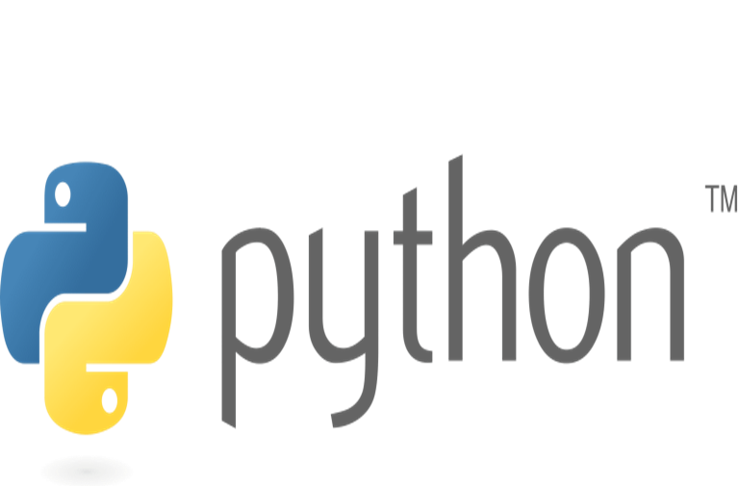
Contents
Classes
Creating and using a class
Working with classes and Instances
Inheritance
Importing Classes
Python Standard library

Slide 4
Python Classes
Class: A class defines the properties and behaviors for objects.
Object-oriented programming (OOP) involves the use of objects to create programs.
An object represents an entity in the real world that can be distinctly identified.
For example, a student, a desk, a circle, a button, and even a loan can all be viewed as objects.
An object has a unique identity, state, and behavior.
An object’s identity is like a person’s Social Security number.
Python automatically assigns each object a unique id for identifying the object at runtime.

Slide 5
Python Classes
An object’s state (also known as its properties or attributes) is represented by variables, called data fields.
A circle object, for example, has a data field radius, which is a property that characterizes a circle.
A rectangle object has the data fields width and height, which are properties that characterize a rectangle.
Python uses methods to define an object’s behavior (also known as its actions).
Recall that methods are defined as functions. You make an object perform an action by invoking a method on that object. For example, you can define methods named getArea() and getPerimeter() for circle objects.
A circle object can then invoke the getArea() method to return its area and the getPerimeter() method to return its perimeter.

Slide 6
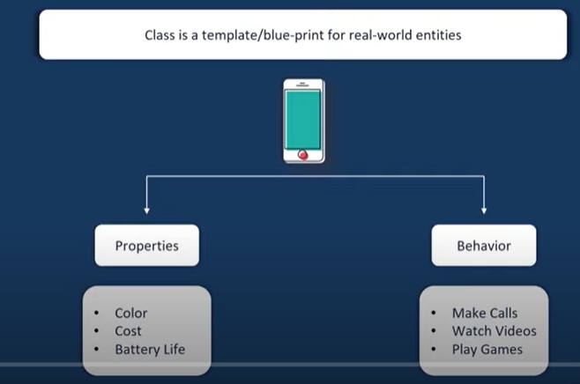
Python Classes

Slide 7
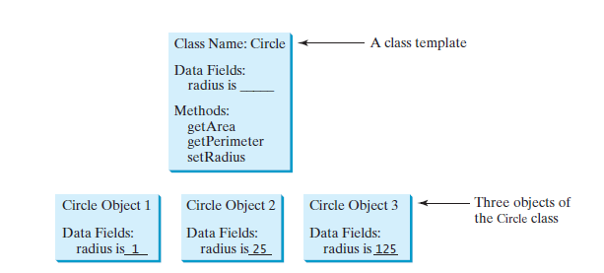
Python Classes

Slide 8
Python Classes
Creating an instance of the class: A class needs to be instantiated if we want to use the class attributes in another class or method.
A class can be instantiated by calling the class using the class name.
The syntax to create the instance of the class is given below.
<object-name> = <class-name>(<arguments>)

Slide 9
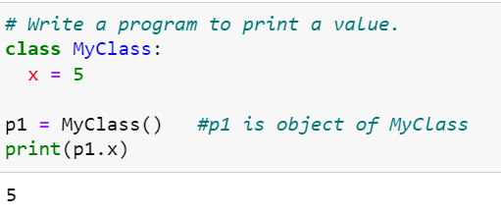
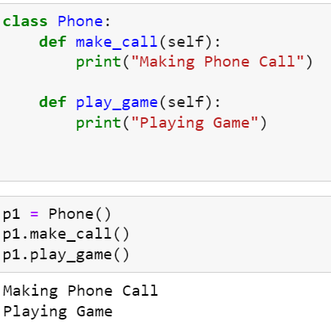
Python Classes

Slide 10
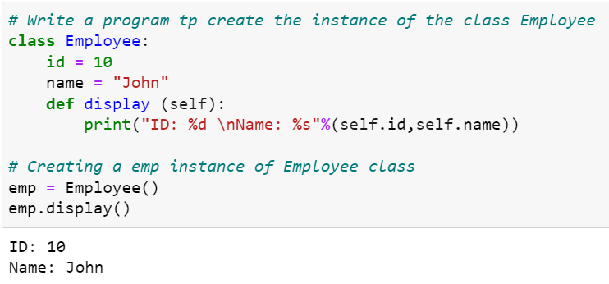
Python Classes

Slide 11
Python Classes
__init__() Function
In Python the __init__() method is called the constructor and is always called when an object is created.
The __init__() Function: It is built-in function.
All classes have a function called __init__(), which is always executed when the class is being initiated.
It accepts the self-keyword as a first argument which allows accessing the attributes or method of the class.
__init__() function is called automatically every time the class is being used to create a new object.

Slide 12
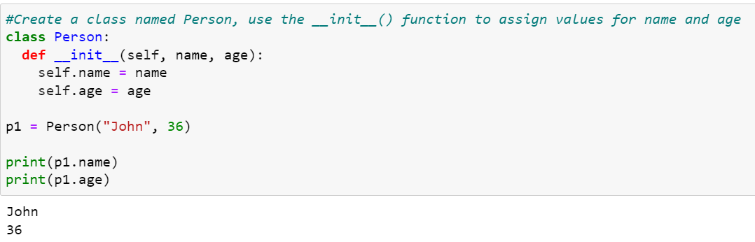
Python Classes

Slide 13
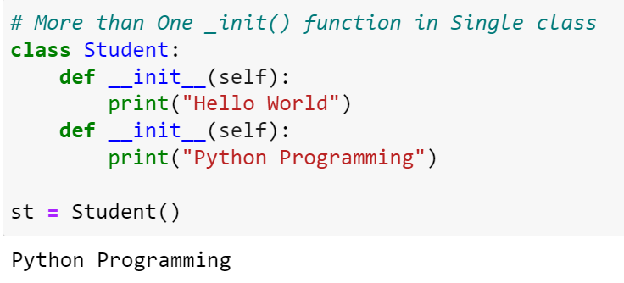
Python Classes

Slide 14
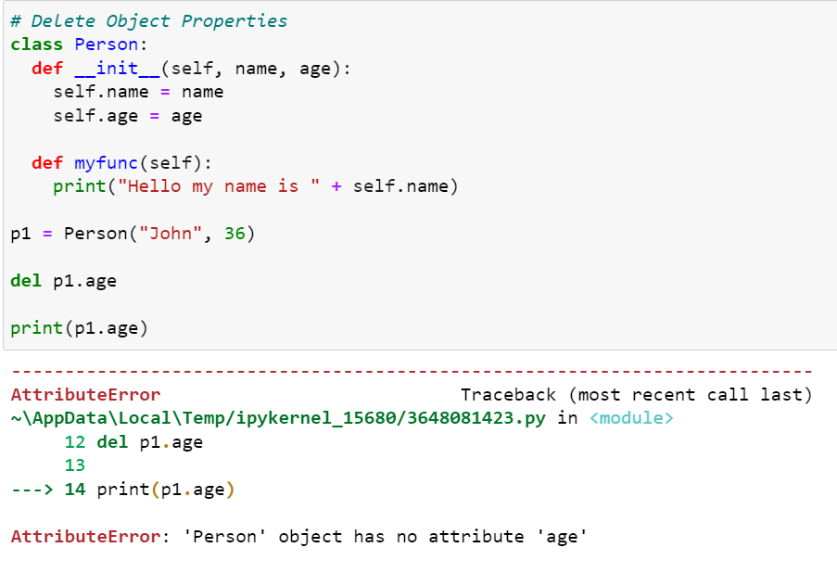
Python Classes

Slide 15
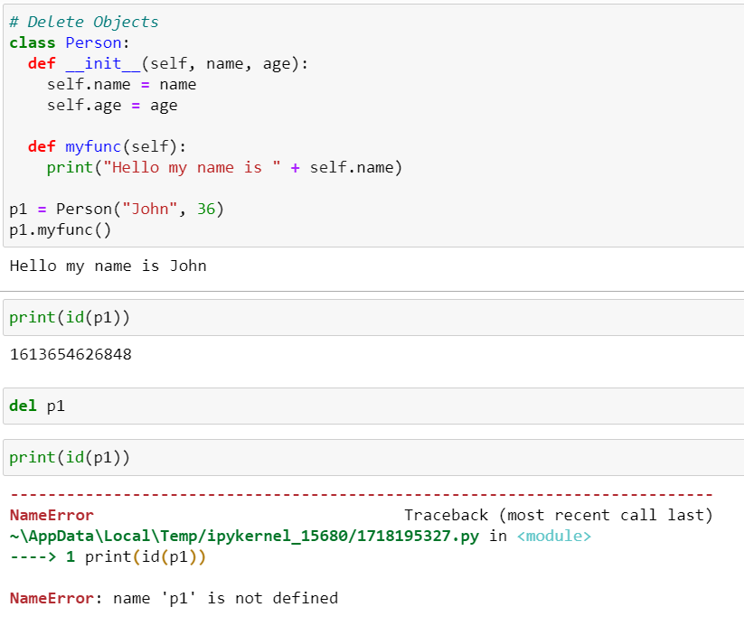
Python Classes

Slide 16
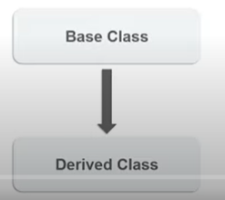
Python Classes
Inheritance: When a child class inherits the properties of a parent class.

Slide 17
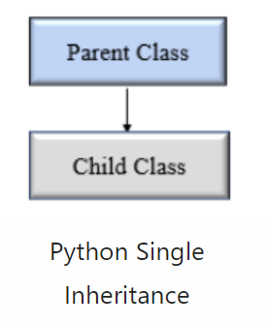
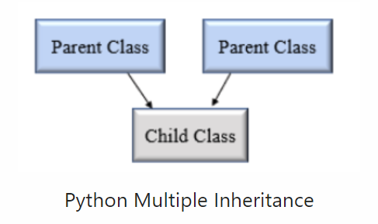
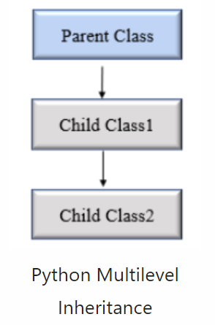
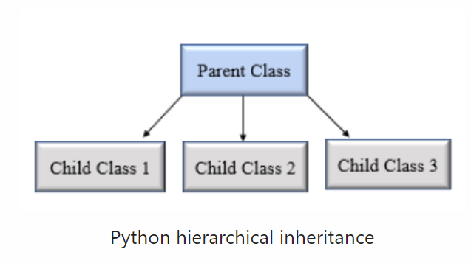
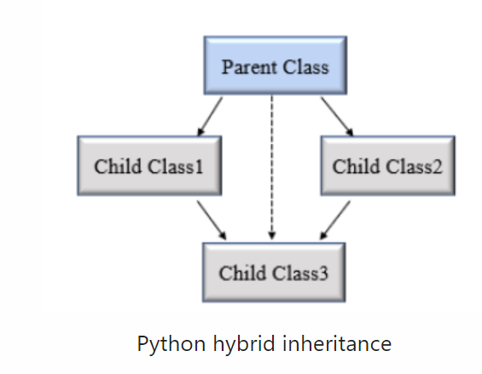
Python Classes
Types of Inheritance

Slide 18
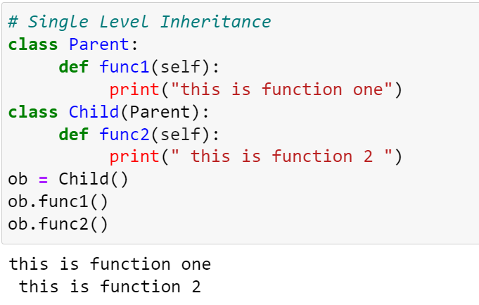
Python Classes
Single Level Inheritance: When a child class inherits only a single parent class.

Slide 19
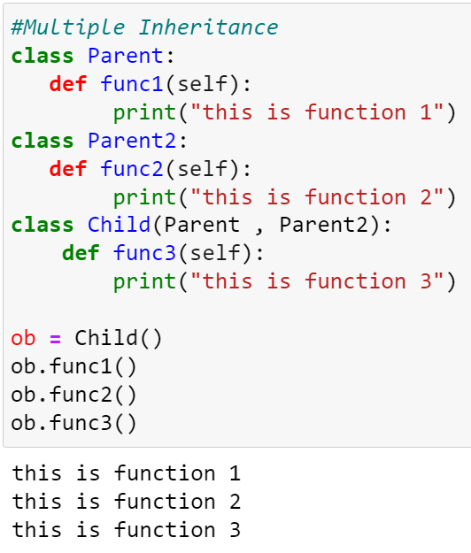
Python Classes
Multiple Inheritance: When a child class inherits from more than one parent class.

Slide 20
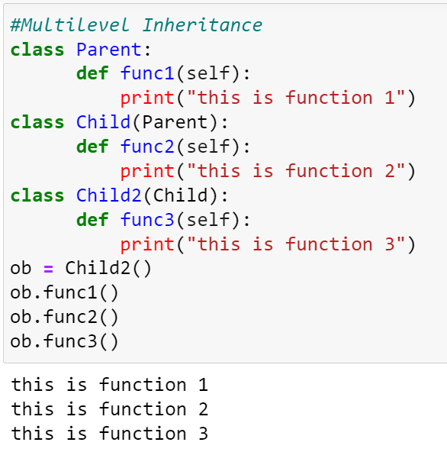
Python Classes
Multilevel Inheritance: When a child class becomes a parent class for another child class.

Slide 21
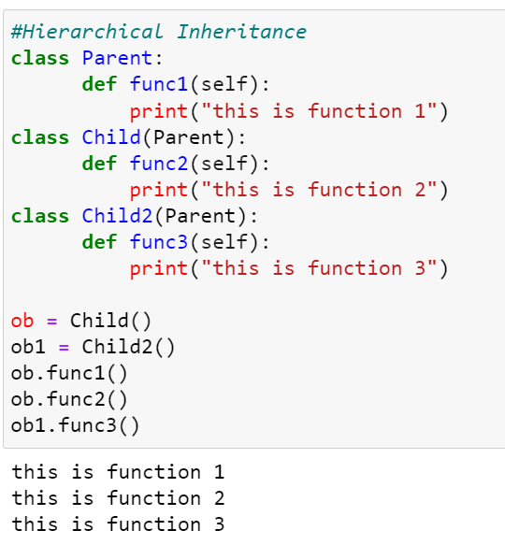
Python Classes
Hierarchical Inheritance: Hierarchical inheritance involves multiple inheritance from the same base or parent class.

Slide 22
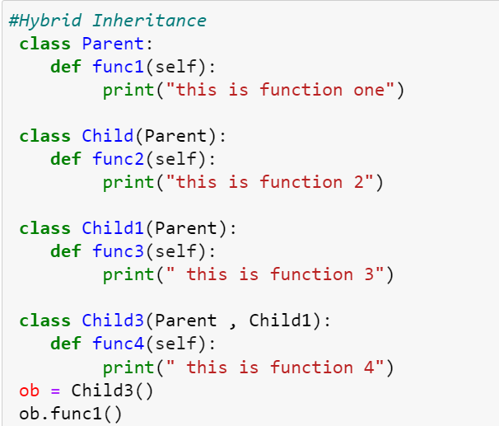
Python Classes
Hybrid Inheritance: Hybrid inheritance involves multiple inheritance taking place in a single program.

Slide 23
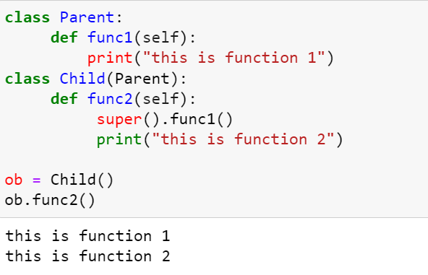
Python Classes
Python Super() Function: Super function allows us to call a method from the parent class.

Slide 24
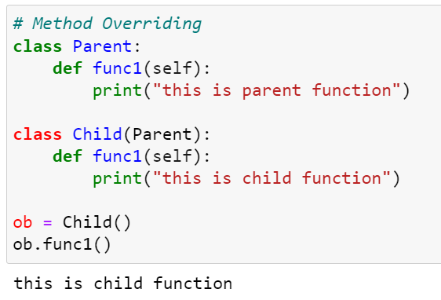
Python Classes
Method Overriding:

Slide 25
Python Classes
There are three types of access specifiers or access modifiers
1). Public access modifier
2). Private access modifier
3). Protected access modifier
Public Access Modifier
All the variables and methods (member functions) in python are by default public.
Any instance variable in a class followed by the ‘self’ keyword ie. self.var_name are public accessed.

Slide 26
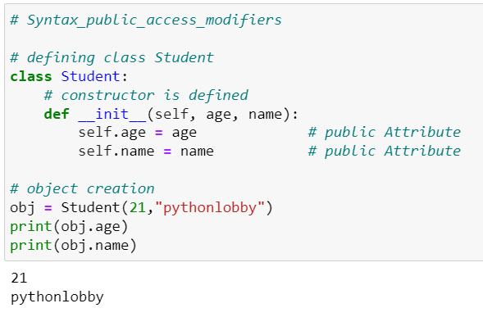
Python Classes
Public Access Modifier

Slide 27
Python Classes
Private Access Modifier : Private members of a class (variables or methods) are those members which are only accessible inside the class. Private members cannot access outside of class.

Slide 28
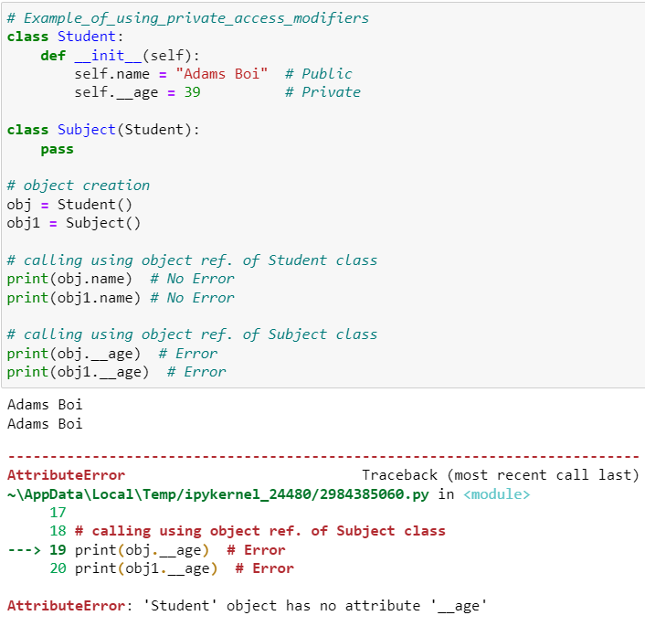
Python Classes

Slide 29
Python Classes
Protected Access Modifier : Protected variables or protected members of a class are restricted to be used only by the member functions and class members of the same class.
And also it can be accessed or inherited by its derived class ( child class ).
The syntax we follow to make any variable protected is to write variable name followed by a single underscore (_) ie. _varName.

Slide 30
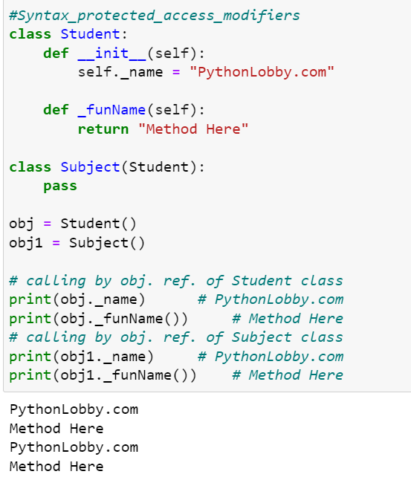
Python Classes

Slide 31
THANK YOU

